Slide 1
PB Scotland Network Learning Event
The Foundations of Participatory Budgeting

Slide 2
www.pbscotland.scot
www.pbscotland.org

Slide 4
Participatory Budgeting / Community Choices / Community Budgeting
‘Participatory budgeting is recognised internationally as a way for local people to have a direct say in how, and where, public funds can be used to address local needs.’
Participatory budgeting
Community engagement & empowerment
Participatory democracy

Slide 5
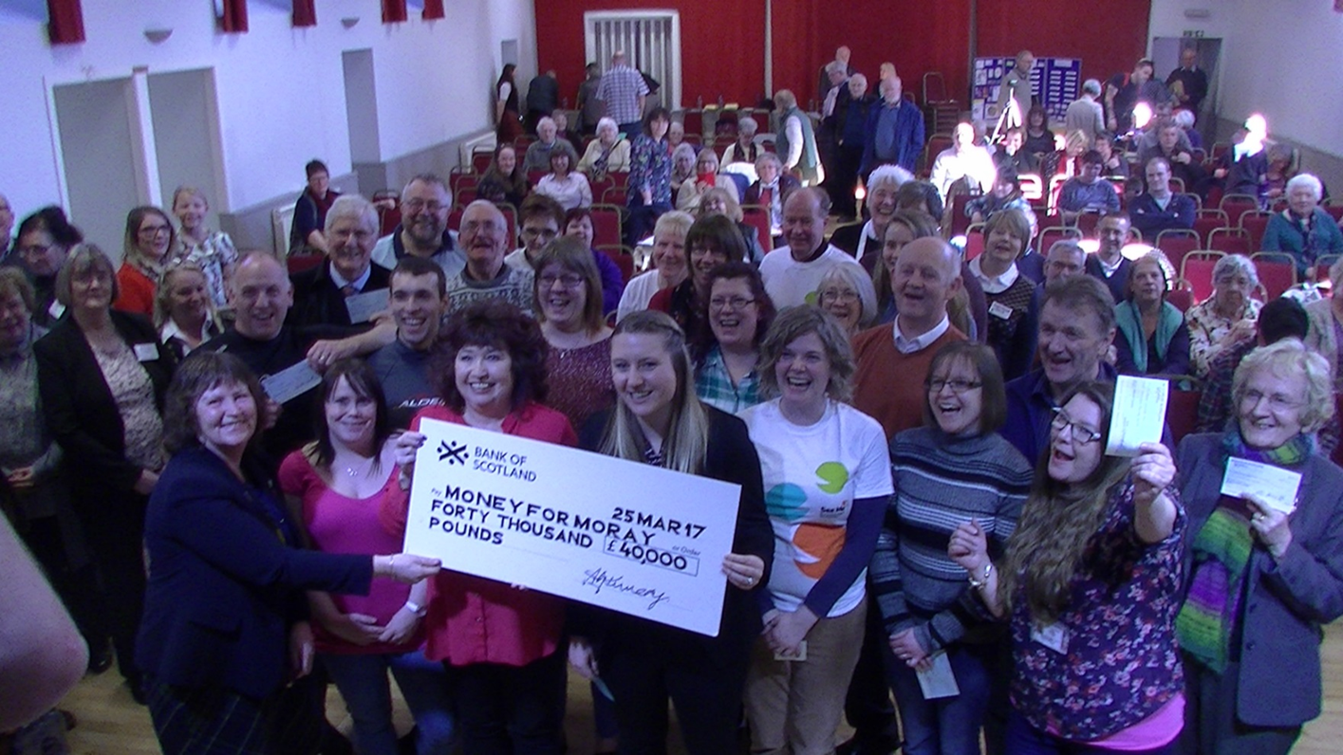

Slide 6
Values
Local Ownership and direct involvement
Equality
Community development & empowerment
Shared responsibility
Deliberation
Transparency
Moving toward the mainstream

Slide 7
What Participatory Budgeting isn’t
Perfect
Just the responsibility of communities
A way to cut budgets
A silver bullet for engagement and democracy
An attempt to pit community groups against each other
A replacement for local representative democracy

Slide 8
Scottish Government– Community Choices
2015/16: £700,000 in match funding for local authorities, awareness raising, research on digital support & establishment of PB Scotland website
2016/17: £1.7M Community Choices Fund – split by local authorities and community organisations. £300,000 for support costs including evaluation, digital and establishment of PB Scotland Network.
2016: SNP manifesto “Setting councils a target of having at least 1 per cent of their budget subject to Community Choices budgeting…backed by the Community Choices Fund to help public bodies and community groups build on examples of best practice.”
2017/18: £1.5M Community Choices Fund, again evenly split. £500,000 on continued support costs and a secondment to CoSLA to help progress the 1% commitment. A focus moving toward mainstreaming PB.

Slide 9
Who?
Local authorities
Community planning partnerships
Health & Social Care Partnerships
Community Councils
Police Scotland
Housing Associations
Regeneration Trusts
Development Trusts
Youth Councils
Equality Groups
Schools
Church groups
Funders?

Slide 10
Infographic overview of 1st Generation PB in Scotland
Source: Review of 1st Generation Participatory Budgeting in Scotland Report by What Works Scotland (20 October 2016)

Slide 11
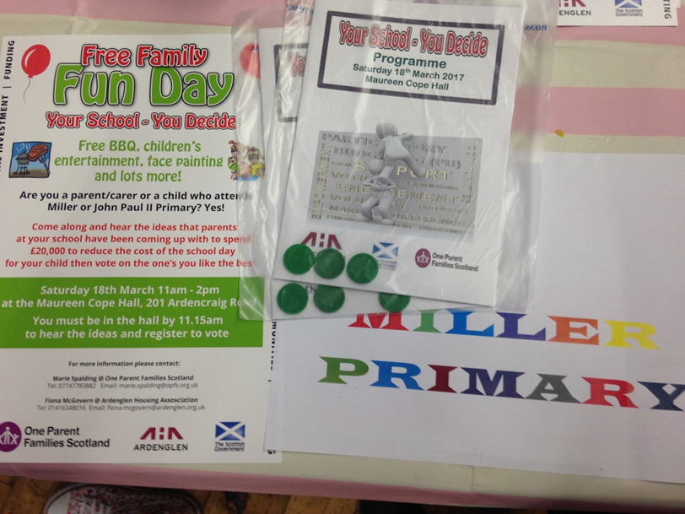
Small grants PB in practice
A community receives money to distribute through PB.
A steering group of community members and an elected rep is established to decide on the process, bid limits, priorities and rules.
The process is given a local name and publicised in the community to applicants
and citizens.
Applicants attend information
sessions, check that it is the right
fund for them and apply to be
included in the voting.

Slide 12
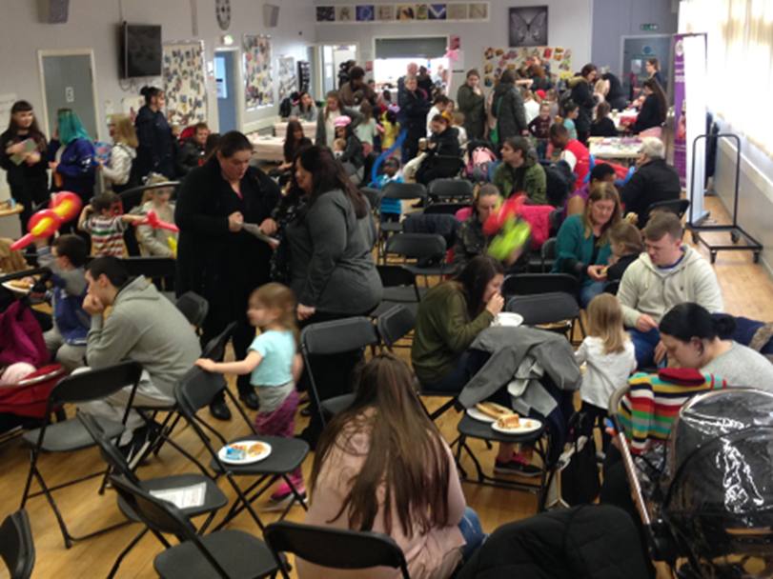
Small grants PB in practice
Steering group screen applications.
A voting event takes place, community members listen and discuss bids, decide who to fund.
Applicants receive funds
with a proportionate grant
agreement & evaluation
Evaluate, learn, inform
and repeat

Slide 14
The future of PB in Scotland
Good PB needs local community capacity building support
– whose role is this?
We need to keep hold of PB that meaningfully engages the community – but how can judge quality?
Dialogue and discussion are ‘where the magic happens’ – how can that be maintained alongside mainstreaming and PB online?
How can we make the leap from community organisations supporting citizens in their own PB events to mainstream PB processes?

