Slide 1
Facilitating dialogue and deliberation
Oliver Escobar, University of Edinburgh
International PB Conference, October 2016

Slide 2
Can PB help to revitalise local democracy?
0 1 2 3 4 5 6 7 8 9 10
0= Not at all
10= Yes, absolutely

Slide 3
How much experience do you have in PB?
0 1 2 3 4 5 6 7 8 9 10
0= Not at all
10= A lot

Slide 4
I enjoy facilitating public conversations
0 1 2 3 4 5 6 7 8 9 10
0= Not at all
10= Very much

Slide 5
I find it difficult to facilitate public conversations
0 1 2 3 4 5 6 7 8 9 10
0= Not at all
10= Very much so

Slide 6
Dialogue + Deliberation
Communication theory
Dialogue
Deliberation

Slide 7
Society as a web of communication patterns
Different patterns of communication create different contexts.
Communication is not only instrumental, but also consequential:
Importance of what gets done (results, outputs)
but also what gets made (relationships, contexts)
and how it gets made (through what communication patterns; with what consequences)

Slide 8
Communication patterns:
common rituals + pitfalls
Exchanging monologues
Pre-packaged arguments
Dominant voices
Posturing
Specialised jargon
Avoidance
Polarisation and oversimplifaction
Confrontational exchanges
Notes:
8

Slide 9
Dialogue
A form of non-polarised conversation that focuses on understanding and relationship-building
Creation of safe spaces
Suspension of assumptions and automatic response (assimilation/opposition)
Finding common ground / exploring differences
Co-creation of shared meanings and vocabularies
Collaborative inquiry
Storytelling
Understanding the contribution of emotions

Slide 10
Deliberation
Information, evidence, stories
Mapping and scrutinising alternatives
Giving (and taking) public reasons
Re-examining and (perhaps) changing preferences
Seeking agreement or consensus
Making informed and reasoned decisions

Slide 11
Debate | Dialogue | Deliberation
Seeks to promote opinions and gain majority support | Seeks to build understanding and relationships | Seeks common ground in order to solve problems
Participants argue, express, persuade and compete | Participants listen, exchange, reach across, reflect | Participants frame and weigh options, and make choices
Outcome: win/lose | Outcome: no decision | Outcome: win/win

Slide 12
PIN diagram (Andrew Acland)
Win-Lose
Positions
visibility line
Interest & values
Needs & fears
Win-Win

Slide 13
The D+D model
Notes:
13

Slide 14
The craft of facilitation

Slide 15
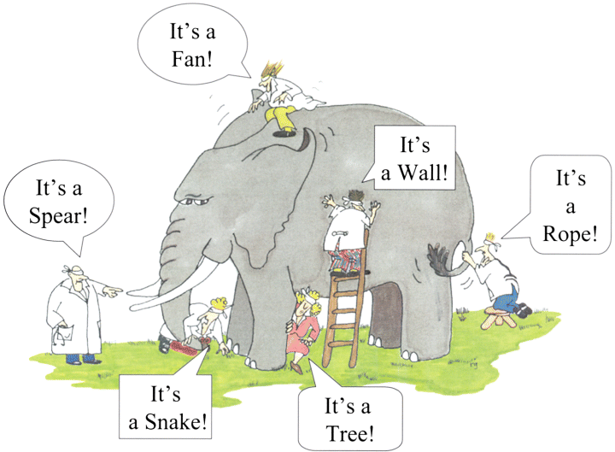
From my perspective…

Slide 16
The blind experts and the elephant
http://www.nature.com/ki/journal/v62/n5/fig_tab/4493262f1.html

Slide 17
Role of facilitators
To help the group meet its aims as fully as possible in the time available (keeping on task)
To encourage the fullest possible participation of the group (inclusiveness)
To maintain an impartial stance on the topic under discussion (impartiality)
Service the needs of each individual AND the group (care)
Welcome conflict but not confrontation (managing difference)
Monitor (and sometimes alter) communication patterns (managing dynamics)

Slide 18
Two different styles of facilitation
Dialogue | Deliberation
Divergent communications patterns | Convergent communication patterns
Inviting exploration and understanding (no judgement) | Inviting scrutiny and judgement
Broadening or deepening stories/experiences | Sharpening / testing arguments
Centrality of experience | Centrality of evidence (which may include experience)
Ethics of care | Ethics of justification
Space for private and public reasons | Space for public reasons only
No pressure to reach conclusion / decision | Pressure to reach conclusion / decision

Slide 19
Facilitation diamond
Dialogue
Divergent phase
Convergent phase
Deliberation

Slide 20
https://oliversdialogue.wordpress.com/public-dialogue-and-deliberation/

Slide 21
Buzzz Q/A

Slide 22
Dialogue and deliberation are key components in the PB processes I know
0 1 2 3 4 5 6 7 8 9 10
0= Not at all
10= Yes, absolutely

Slide 23
Dialogue and deliberation should be key components in all PB processes
0 1 2 3 4 5 6 7 8 9 10
0= Not at all
10= Yes, absolutely

Slide 24
thank you

