Slide 1
PB in Denmark Has the welfare state undermined the need for citizen participation?
By Morten Ronnenberg, Centre for Good Governance (DK)
Søren Noes, Citizen and PB Champion in the Council of Hedensted

Slide 2
Overview
7 out 98 councils in all of Denmark have tried or is doing PB
7 out of 7 went on study tour to the UK
15-20 projects – varying in size from 9,000 to 180,000 GBP
PB is a provincial thing to do … →
Why?
Copenhagen

Slide 3
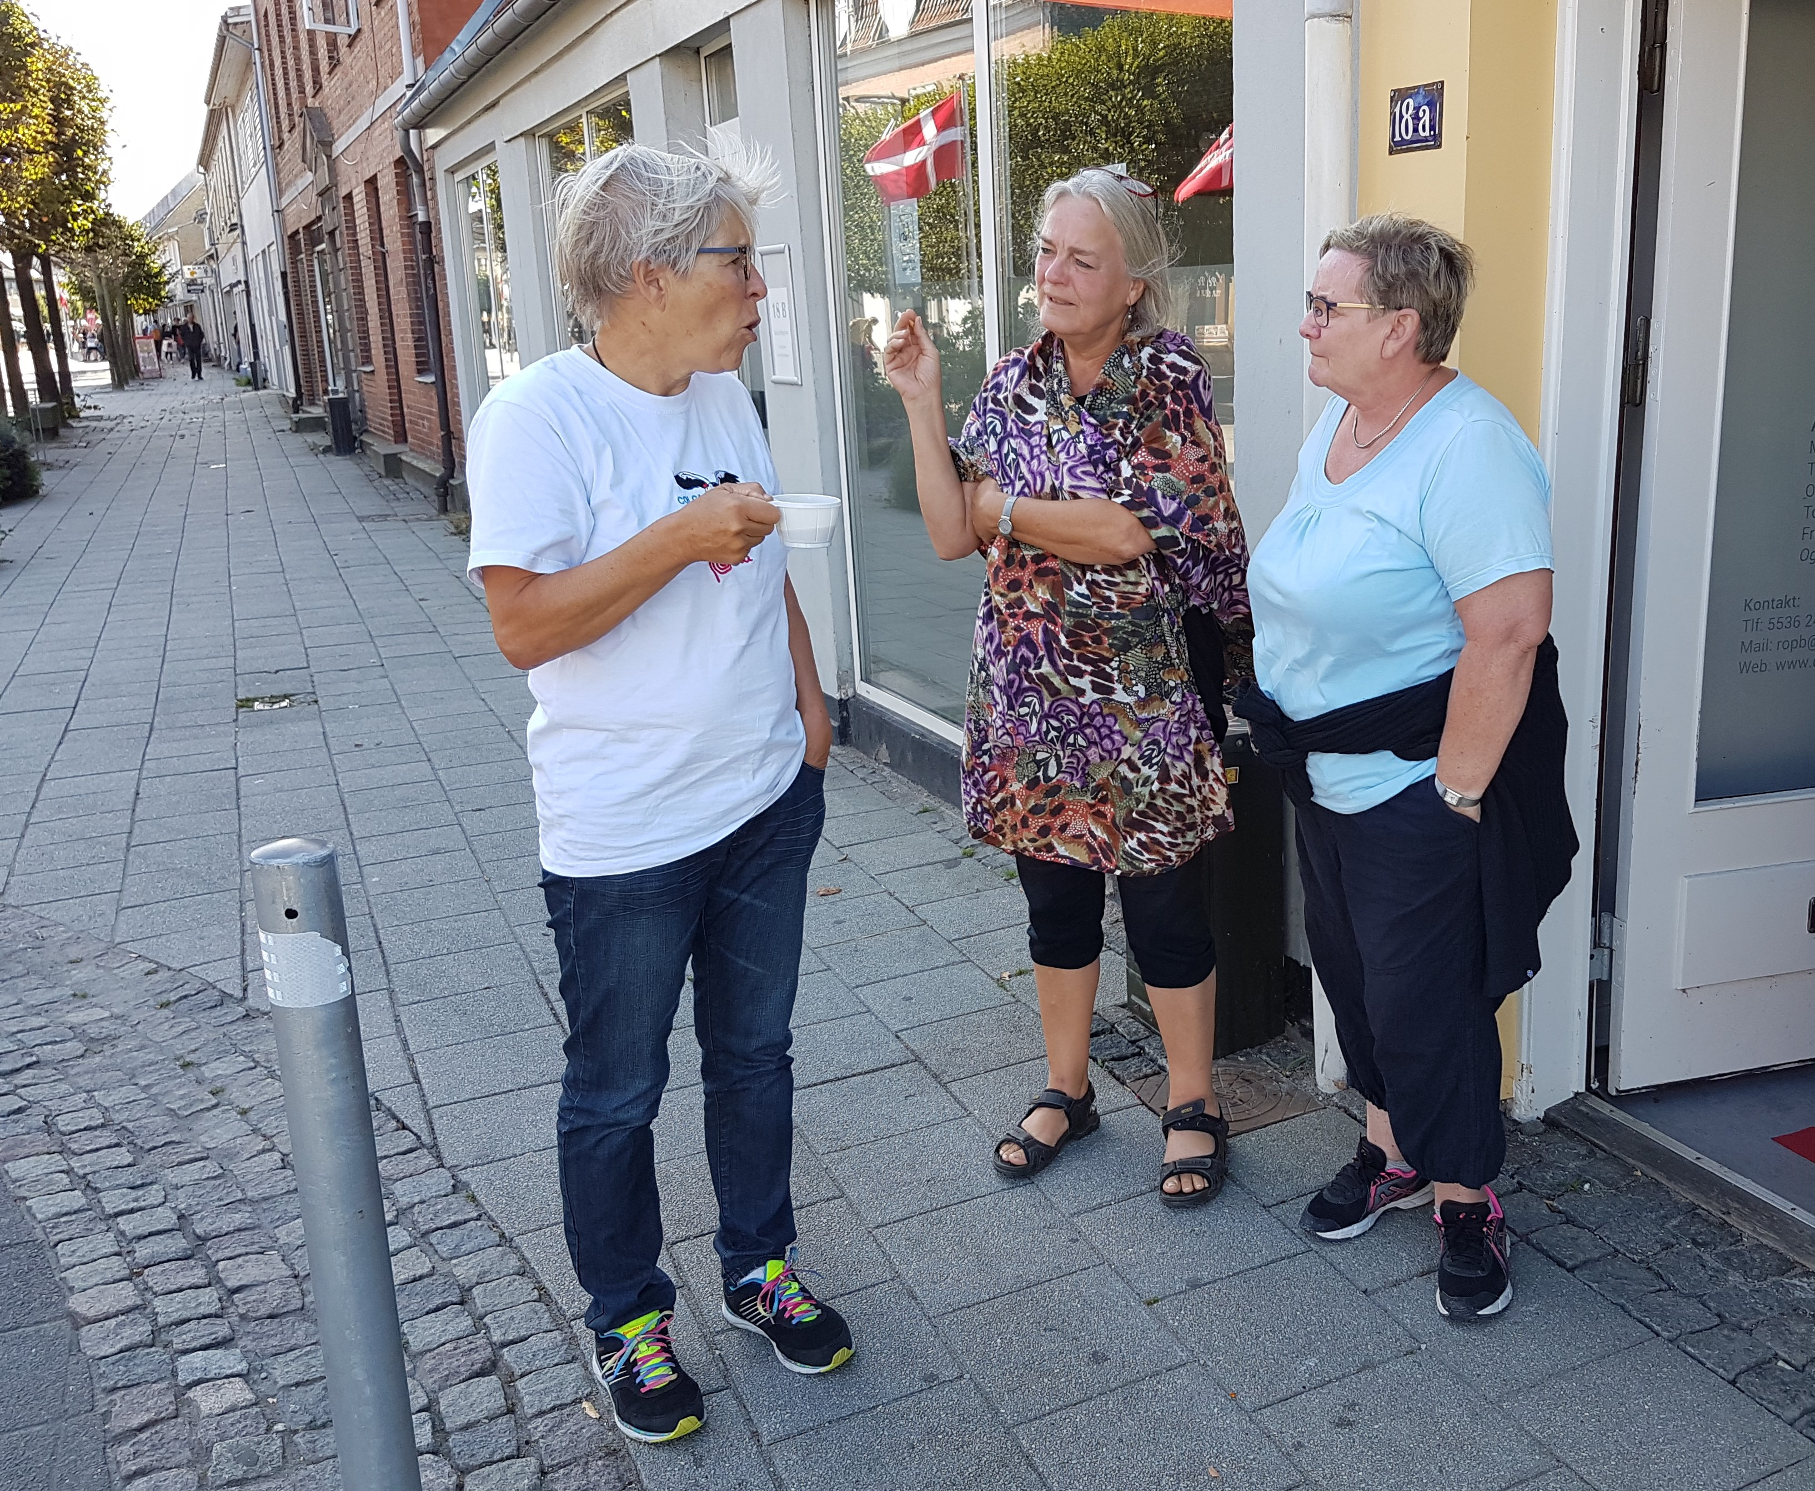
PB Ambition – The Big Agenda
Too many
Too few
TAX INCOME
Volunteers

Slide 4
Why do Danish councils do PB?
Closing the welfare gap
Looking for co-creation of services
Mobilising new volunteer groups
Local ownership and responsibility
Creating community resilience

Slide 5
Danish traditions for voluntarism
39% of the population above 16years of age did voluntary work in 2015 (28% in Scotland)
Every 1 in 3 of the pensioners do voluntary work
45% of people with children do voluntary work
101,000 voluntary organisations – equivalent to 1 organisation for every 56 persons including children/elderly
70% of all voluntary work is done in or through civil society organisations /CSOs
Trend: still more volunteer outside the associations – eg on refugee issues.
The state and councils support volunteering if through organisations – by law every Danish council must engage with civil society organisations and must provide financial support to CSOs (§18)

Slide 6
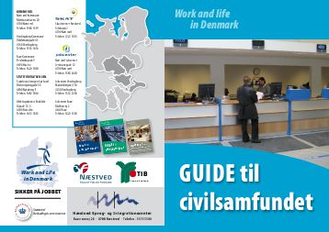
Public financial support to civil society
The state and councils support volunteering if through organisations
by law every Danish council must engage with civil society organisations and must provide financial support to CSOs (§18)
Council of Kolding – 600,000 £ for CSO (91,000 inhabitants)
Many funding instruments

Slide 7
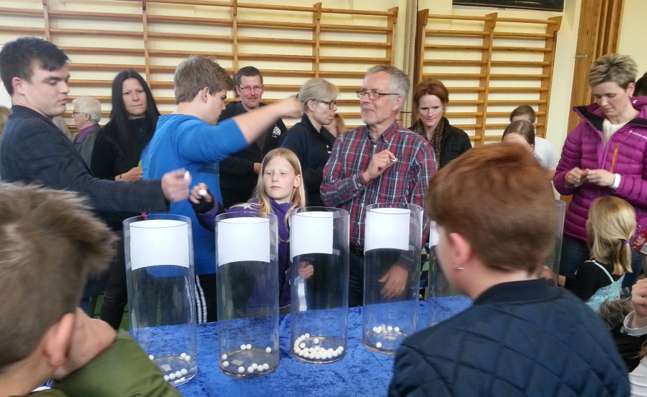
Thematic focus of Danish PB
Engage new and more volunteers
Strengthen health and recovery
Mobilise elderly people
Development of local/ rural communities
Strengthened integration of immigrants/ refugees

Slide 8
Main challenges
For the council / civil servants
For people
Getting people to understand the concept
Mobilise people – turn out often low
Demands staff time for support
Relying on commitment of individuals
‘Super volunteers’ lose power – but who wants it?
To find it relevant
To invest time
Too small pots of money
Facebook is easier
Traditional committee system works well
Immigrants – we are too distant from everything to give this priority

Slide 9
Main successes
For the council / civil servants
For people
Better dialogue with people
More and new people mobilised
More young and children engaged
Rewarding in terms of commitment
Focus on relational work rather than infrastructure perspective
Using organisations and existing democratic structure is more sustainable
Fun and relevant – when small
Less bureaucracy appreciated
Rural areas create networks
Repetitive big scale is works well
Lot’s of debate on facebook (but the usual suspects)

Slide 10
Questions to ponder? Debate for 10 min – groups of 3-4
A – What do we do to engage people when pots of money are not enough to mobilise?
B – How do we go into scale with PB if this requires more support and facilitation but staff time is what you lack?

Slide 11
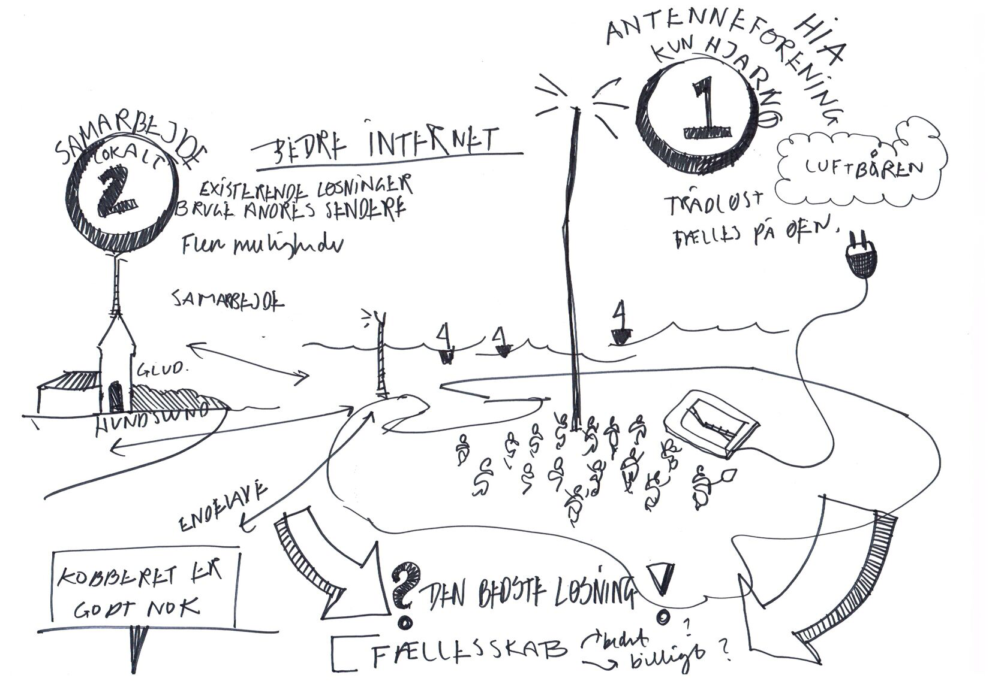
Experience from Hedensted

Slide 12
Experience from Hedensted

Slide 13
Questions to ponder ? Debate #2 - for 10 min – groups of 3-4
C – How do we move PB from ‘nice to have’ things to ‘need to have’ services? – or should we?
D – How do we ensure that PB is not just a new management tool? – i.e. less funds and more people to share and decide?

Slide 14
Summary and feed back to plenary
Conclusions from the audience:
xxx (from flipchart)
yyy
zzz
PB works in Denmark when merged and integrated with an existing structure
Scale and volume matters. PB may disappear if it is not scaled up.

