Slide 1
Growing PB in Scotland
PB Scotland Learning Event
Wednesday 30th March 2022

Slide 2
Session Overview/Purpose
Part of a series of Learning Events aimed at re-establishing PB as we emerge out of the Covid-19 pandemic
Previous events have looked at:
The barriers to PB during Covid-19 and how people have responded to the challenges
The strategic framework for taking PB forward in Scotland
This event aims to:
Focus on some areas for PB development as we refresh, re-energise and re-establish PB as a key element of the development of participatory democracy in Scotland

Slide 3
Today's Session
10.00am Introduction, background and context
10.15am Breakout Session 1
11.10am Break
11.20am Plenary – main points from Session 1
11.25am Breakout Session 2
12.20pm Plenary – main points from Session 2
Event reflection and feedback
12.30pm Finish

Slide 4
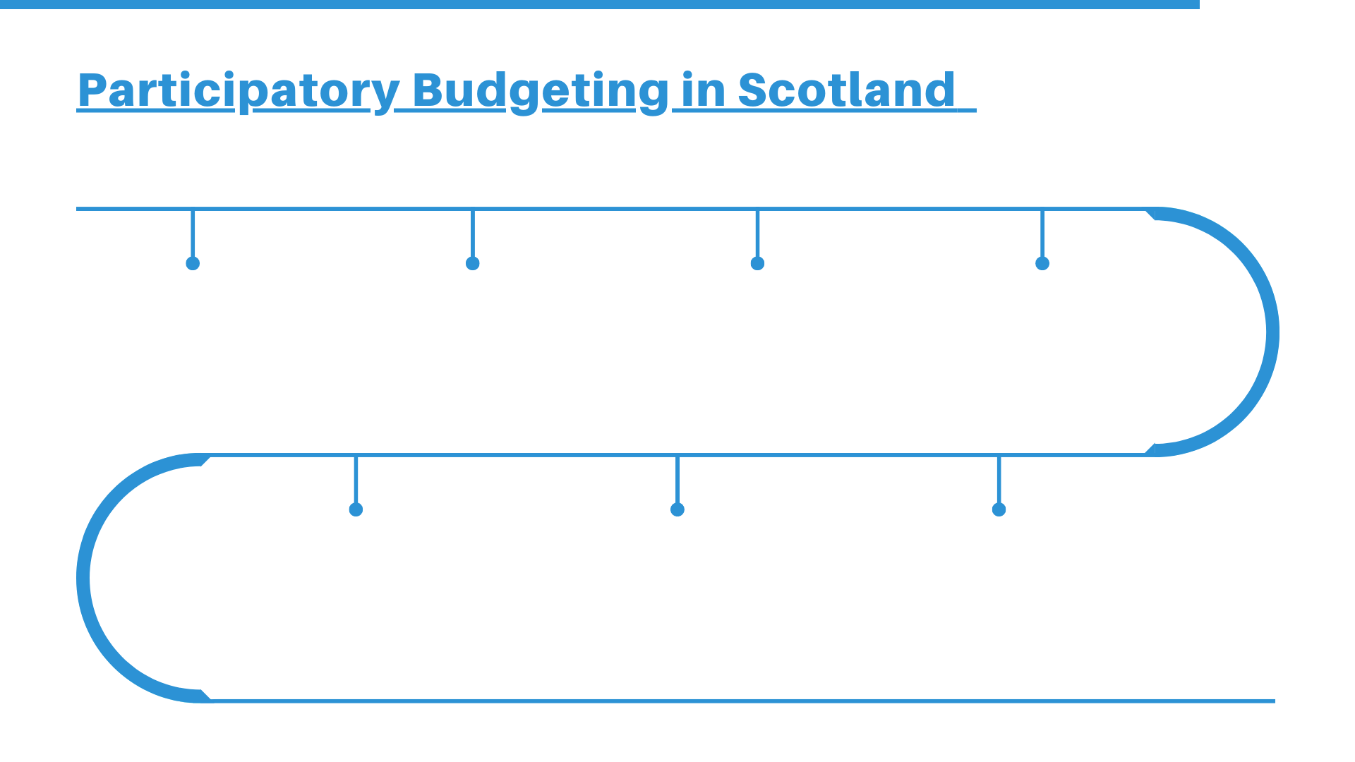
2018: ‘PB Charter for Scotland’ launched: co-produced by community organisations and agencies.
2019: Scotland included in the Global Atlas for Participatory Budgeting for the first time.
2019: The PB Scotland Conference 2019: Going Global sees more than 200 people from countries across the world come together in Edinburgh.
2020: Scottish Government publishes Pupil Equity Fund guidance 2021-21, including clear reference to using PB in schools.
2020: Global Pandemic sees Scotland’s PB activity moved entirely online.
2020: New national PB Strategic group launches to support the development of participatory budgeting across Scotland.
2021: New research explores digital tools for PB in Scotland.

Slide 5
Over the past year …
National Strategic Group develop the PB Framework for Scotland
Continued development of mainstream PB across Scottish Local Authorities
Groups start to run PB processes again – using a combination of face-to-face and digital methods
Green PB emerges as a priority of the Scottish Government

Slide 6
Current opportunities (and challenges)
Policy context – drive for increased community participation and influence in public policy-making – support for citizens assemblies, engagement with Scottish Parliament, review of CE Act, etc.
The experience of community-led response to COVID and greater involvement of communities in resilience
Increasing focus on tackling climate change and tackling (child) poverty
The challenge of re-engaging and re-booting participation – and finding new ways of working
The challenge of engaging and involving the people who face the greatest barriers to participation – tackling inequalities

Slide 7
Today’s programme – Growing PB
Focus on 4 key areas:
Growing involvement – of elected members, community planning and other agencies – in PB
Growing mainstream PB – considering different models
Growing PB in schools and with young people
Growing Green PB – tackling climate change

