Slide 1
PB in Ayrshire – the story so far……..
Pam Crosthwaite - North Ayrshire Council
Gus Collins - South Ayrshire council
Dot Grieve – East Ayrshire Council

Slide 2
PAN AYRSHIRE WORKING
All three local authorities attended introductory workshop on PB (2014)
Joint bid made to Scottish Government for initially 4 Training Days (2015) to enable us to;
  increase awareness, understanding and develop skills of staff and partners including community representatives
  further raise awareness and promote PB as a method of community engagement and enhancing local planning
  explore opportunities to take forward PB locally
  continue to develop stronger communities by building on the asset based work undertaken through Ayrshire 21 and AHEAD which is a joint project with NHS
Co-designed training programme with the PB Partners focus for the training was a mix of Pan Ayrshire sessions with some bespoke sessions delivered within each local authority.

Slide 3
PAN AYRSHIRE WORKING
Strong history of partnership working across Ayrshire and provided the opportunity to continue this working relationship
2nd bid to Scottish Government to
  Film local PB events to create DVD to use to promote PB
  Develop PB Network across Ayrshire
  Explore use of digital tools
Individual bids for funding to Scottish Government for funding to pilot PB in communities early 2016
Community Choices Funding

Slide 4
NORTH AYRSHIRE – Key Points
PB Steering Group: CPP - Council , HSCP, NHS, Third Sector Interface and Fire Scotland.
Brand - £Your Money, You Decide£
Initial funding of £120k secured from Scottish Government; Ayrshire Community Trust; North Ayrshire Council; Big Lottery ( September 2016)
Delivery of 6 Locality PB events
3 PB events so far – Kilwinning, 3 Towns and Garnock Valley.
Dedicated web pages on NAC and CPP websites; events promoted by PB Scotland website.

Slide 5
Kilwinning PB ‘Decision Day’
  Enjoyed the chance to participate in where the money goes
  ‘I think it is a good way to get people involved’
1st PB event - Saturday 19th March at Ayrshire College Campus
‘Decision Day’ - £19k available
Maximum award: £700.
Non-constituted groups encouraged to apply; supported to find a ‘host’ organisation.
56 applications received from wide range of local groups/individuals –
22 groups pitched their ideas at the event
19 groups secured funding.
200 people attended; everyone aged 8+ living, working or volunteering in Kilwinning eligible to vote.
#pbKilwinning

Slide 6
‘Three Towns’ PB Decision Day’
2nd PB event: Saturday 21st May.
Steering group included volunteers from the Kilwinning PB event & community reps from the Three Towns.
Real buzz(!) – entertainment, stalls, quizzes, mocktails, silent disco, fire engine, & PB bingo.
40 groups submitted applications, with 37 groups presenting at Decision Day.
29 groups secured funding from the pot of £19k.
173 people registered on the day.
121 evaluations were completed, with overwhelmingly positive feedback.
Groups supporting each other e.g. Sea Cadets support to a local community garden; group who refurbish computers offered a PC to a group who needed one.

Slide 7

NORTH AYRSHIRE

Slide 8
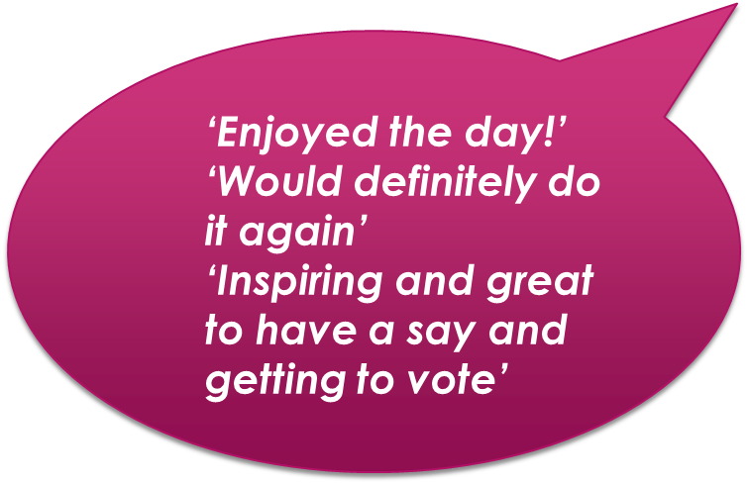
Young People’s PB Events
Local Youth Action Fund transferred to PB
5 Locality Youth PB events held over the summer .
Different presentation format.
Each group given 3 minutes to present with storyboard
Voting with ‘PB’£££’s.
59 youth groups have secured funding from a pot of £24, 500
One event used Digital Voting, in partnership with Young Scot
6 Further events to be held in November – all using Digital Voting, in partnership with Young Scot and local schools

Slide 9
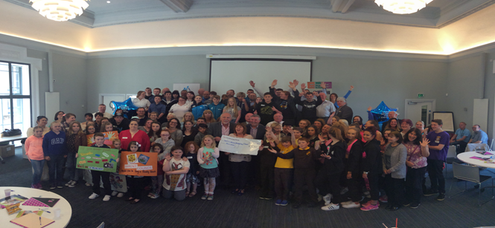
NORTH AYRSHIRE - Summary
480 people have attended PB events so far.
153 Community Groups have secured funding.
£79,000 has been allocated.
Strong PB Partnership has been established.
Paperwork and processes established but ongoing learning and development.
Community connections and engagement increased
Contact groups within 6 months, to explore impact of funding
Commitment to contact all unsuccessful groups.

Slide 10
NORTH AYRSHIRE – The Future
3 locality PB events are planned for October and November
Locality Partnerships responsible for ensuring PB embedded in the 6 Localities
Building on and increasing community involvement in planning and running events
Community Choices Funding secured to develop and extend digital voting (initially with young people) and,
PB event with Community Councils and a thematic PB event focussing on mental health and well-being.

Slide 11

SOUTH AYRSHIRE – Key points
6 PB events held across South Ayrshire in first cycle
£93,500 allocated so far
PB approach developed locally and fund distributed through Health and Social Care Locality Planning infrastructure
Average attendance of 108 voters at each event
PB introduced a new process which broadened engagement with grassroots groups and increased participation from wide range of groups and projects
Aligns with Health and Social Care Priorities opens up additional opportunities for meaningful co-production at a local level

Slide 12
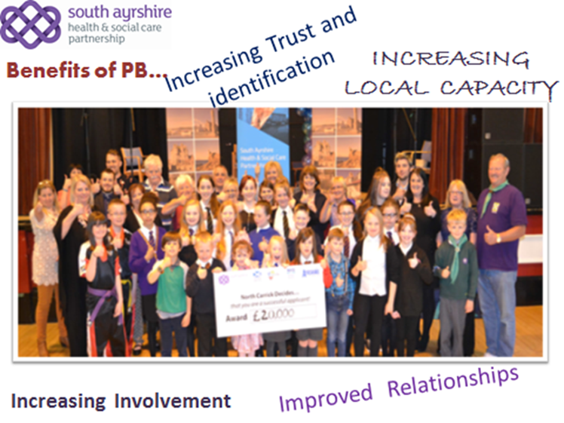
MAYBOLE & NORTH CARRICK LOCALITY
Allocated £20,000 on 7th May
26 groups ‘pitched’ to an audience of 150
20 groups were fully funded and 6 runners up received a share of what was left
Planning and delivery of the day had a big input from local stakeholders who also contributed £10,000

Slide 13
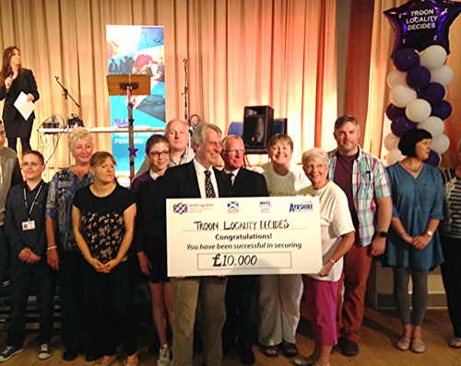

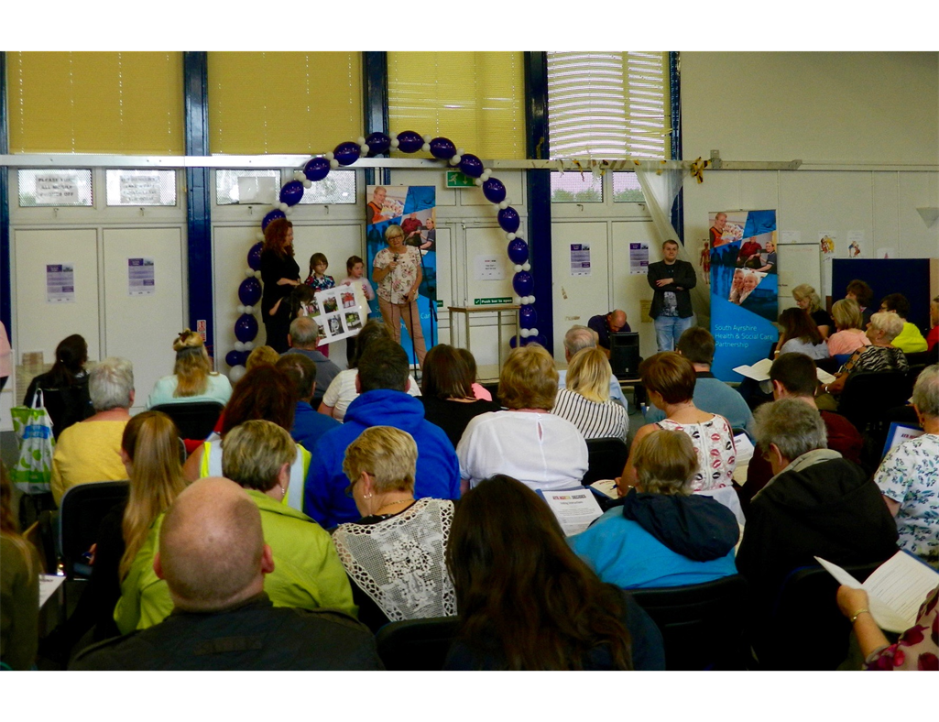
SOUTH AYRSHIRE – Locality Events
TROON LOCALITY & AYR NORTH LOCALITY
£10,000 at each event
Over 160 attended across both events
28 groups fully funded
8 shared remaining funds

Slide 14
SOUTH AYRSHIRE – SUMMARY
Involving local stakeholders in the planning and delivery of PB achieves community led PB and builds confidence and optimism
Used different approaches to vote at events such as voting key pads which saved time, injected a fun element to the process and allowed us to understand more about our audience
The randomness of different funding streams can lead to problems, although these are good problems to have

Slide 15
SOUTH AYRSHIRE – The Future
Next cycle of locality events planned - funding of £121,000 secured
Big Lottery Funding
Developing use of Digital Tools called Your Priorities with Citizens Foundation (Iceland). Can be used for getting feedback on emerging themes or priorities
To widen staff base for supporting applicants
To stimulate and support more applications from marginal groups
Exploring further links with community benefits to look at potential contributions for PB overhead costs including wind farm community benefit companies

Slide 16

EAST AYRSHIRE - Key Points
Funding from Scottish Government and EA Health and Social Care Partnership
2 Pilots with communities who had a Community Led Action Plan
‘ You Decide’ £10,000 for each pilot
All funding went to the communities
Kept it simple
Opportunity to increase knowledge, skills and confidence of staff, partners and community representatives in taking PB forward

Slide 17
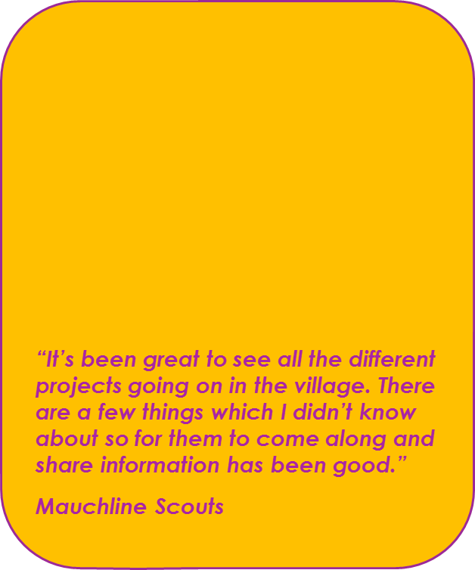
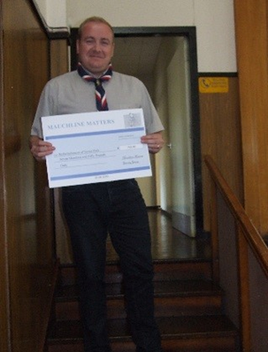
MAUCHLINE MATTERS
Community PB Steering Group established
PB event held on Sunday 5th June in Mauchline Community Centre
Personalised Community Event
Applications accepted for minimum of £100 maximum £750
Those eligible to vote had to be a resident of the parish of Mauchline and be in Primary 6 or above
A total of 21 applications were received and all invited to do 3 minute presentation
18 projects received funding on the day
65 people attended the day and 53 voted

Slide 18
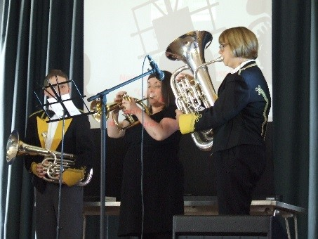
VALLEY VENTURES
PB event held on Saturday 25th June in Darvel Town Hall
Brought two communities together to hold a joint event and joint PB Steering Group set up
Applications up to a maximum of £1000, no minimum
Those eligible to vote had to be a resident of Newmilns or Darvel and be in S1 or above.
A total of 35 applications were received and 25 invited to present.
15 projects received funding on the day
118 people attended the day and 88 voted

Slide 19
EAST AYRSHIRE - Summary
2 Successful Pilots with 3 communities & continued commitment to PB
Approach strengthened engagement and built on the work done by communities in developing their own Community Led Action Plans
56 applications received in total and 33 projects supported by the community
New connections made in and across communities
82% of those attending thought the events were a good way of getting people involved on how funding should be spent in their area
Some members of the Steering Groups have offered to mentor other communities for future events
Developed localised materials and training

Slide 20
EAST AYRSHIRE – The Future
Continued commitment to PB
Scottish Government Community Choices Fund total of £211,000
  rollout PB to 12 Community Action Plan areas in 2016/17
  complementary bid from EATRF to deliver 4 PB events with tenants and residents out with Community Action Plan areas
Commitment from EA Health and Social Care Partnership
Links with the Big Lottery Fund
Discussions with other Services about using PB approach
Want to explore other PB models including digital tools, linked to South Ayrshire model

Slide 21
AYRSHIRE PB – OUR JOURNEY
AYRSHIRE PB VIDEO
https://www.youtube.com/watch?v=6U7NmkwG91k&feature=youtu.be

Slide 22
AYRSHIRE PB – OUR JOURNEY
QUESTIONS

