Slide 2
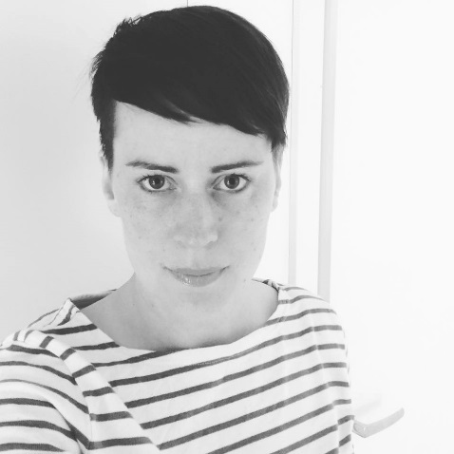
Anders Nordh
Malin Svanberg

Slide 3
The Swedish Association of Local Authorities and Regions (SALAR)
SALAR represents Sweden’s 290 municipalities and 20 county councils/regions.
It acts as an employer’s organisation, and it defends and promotes the interests of its members, for example by working to strengthen local selfgovernment and the development of regional and local democracy.

Slide 4
Facts
Population: 9 million inhabitants
Form of government: Constitutional monarchy, parliamentary democracy
Parliament: The Riksdag, with 349 members in one chamber
Capital: Stockholm. The largest city in Sweden. Population 864 324
Bjurholm: The smallest municipality in Sweden, 2 517 inhabitants
Average municipality, 16 000 inhabiants

Slide 5
Revenues of the municipalities…
Taxes 69%
Government grants 14%
Fees and charges 7%
Sale of services and contracts 1%
Rents and leases 4%
Other revenue 5%

Slide 6
High turn out

Slide 7
But…
Kommun | Distrikt med högst valdeltagande | Distrikt med lägst valdeltagande | Differens 2014 | Differens 2010
Göteborg | 92,6 | 37,4 | 55,2 | 48,1
Stockholm | 94,8 | 40,8 | 54,0 | 58,1
Malmö | 93,4 | 39,7 | 53,7 | 49
Botkyrka | 90,9 | 42,3 | 48,6 | 43,6
Huddinge | 91,9 | 46,1 | 45,8 | 42,7
Haninge | 89,8 | 44,6 | 45,2 | 41,2
Södertälje | 86,8 | 42,5 | 44,3 | 36,2
Borås | 92,5 | 50,5 | 42,0 | 38,2
Halmstad | 93,5 | 52,2 | 41,3 | 31,8
Sollentuna | 91,1 | 52,6 | 38,5 | 33,7

Slide 8
PB in Sweden since 2009

Slide 9
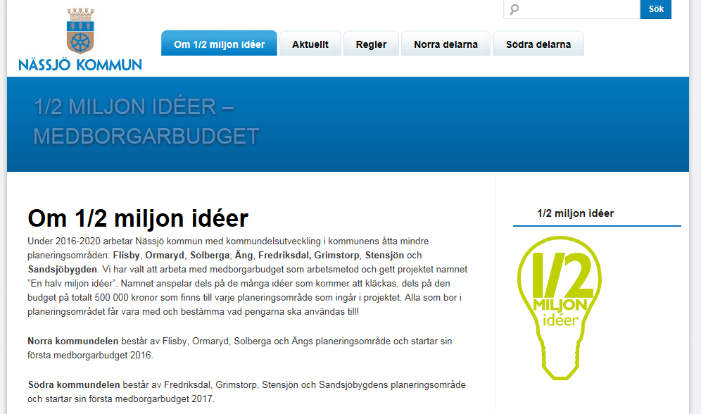
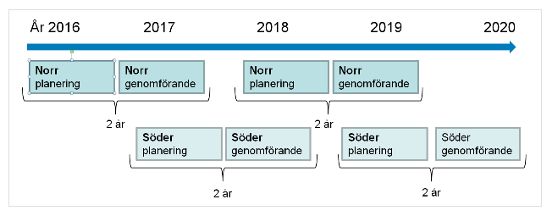
Inhabitants 16 678

Slide 10
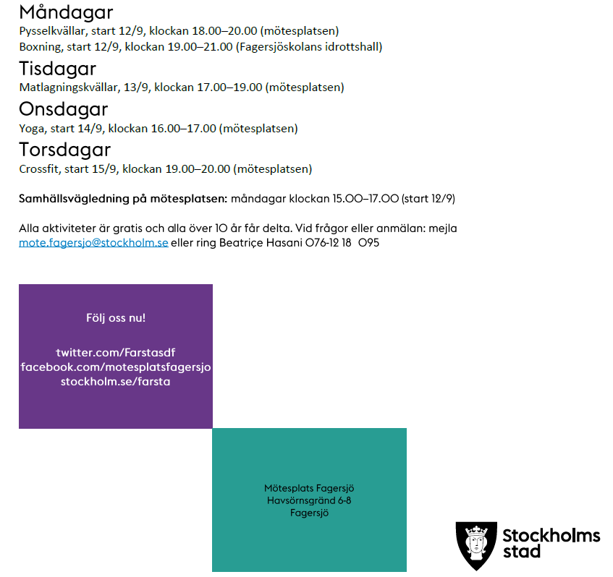
Inhabitants (district) 55 300

Slide 11
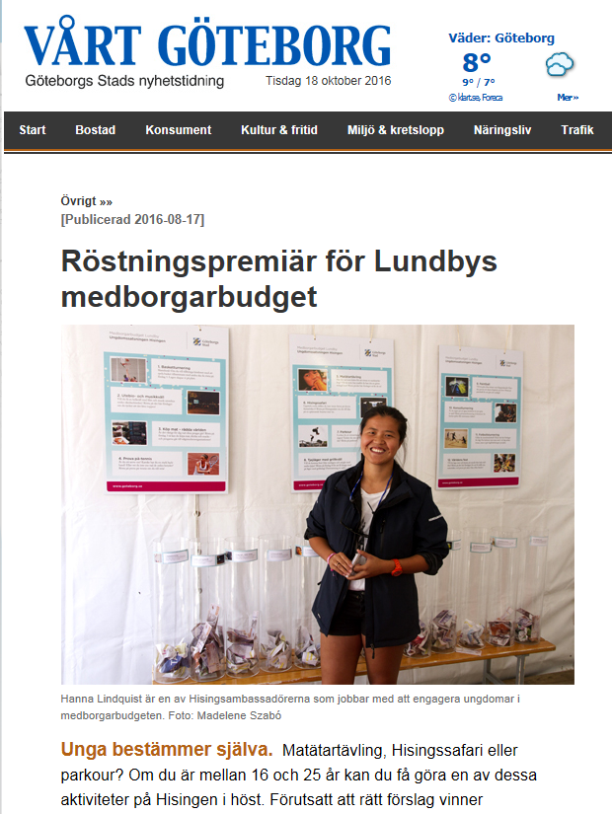
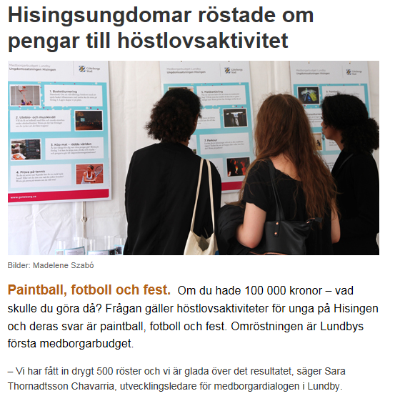
Inhabitants (district) 144 000

Slide 12
Visual budget started as a prototype
Open source

Slide 13
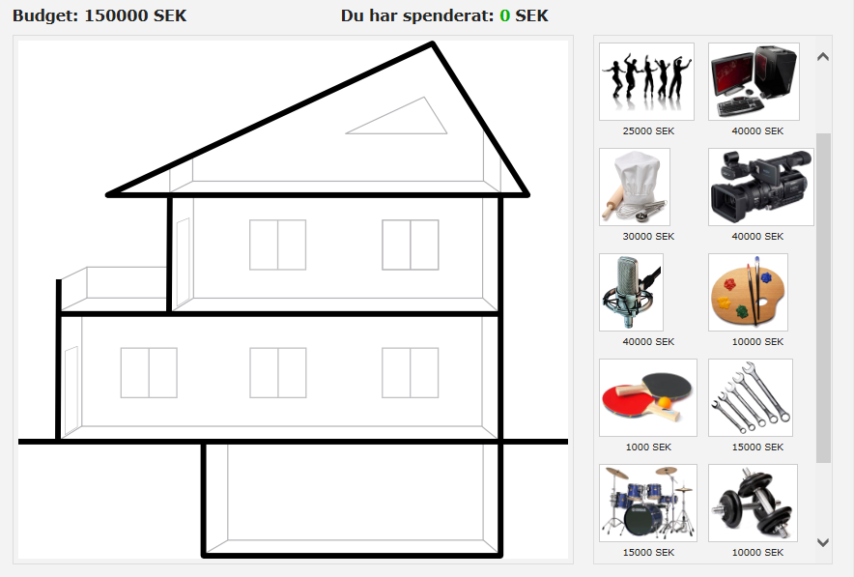
Another version

Slide 14
Starting points!

Slide 15
Learning process
Visual
Also analog

Slide 16
Now you can decide!
http://uk.medborgarbudget.se/

Slide 17
http://uk.medborgarbudget.se/

Slide 18
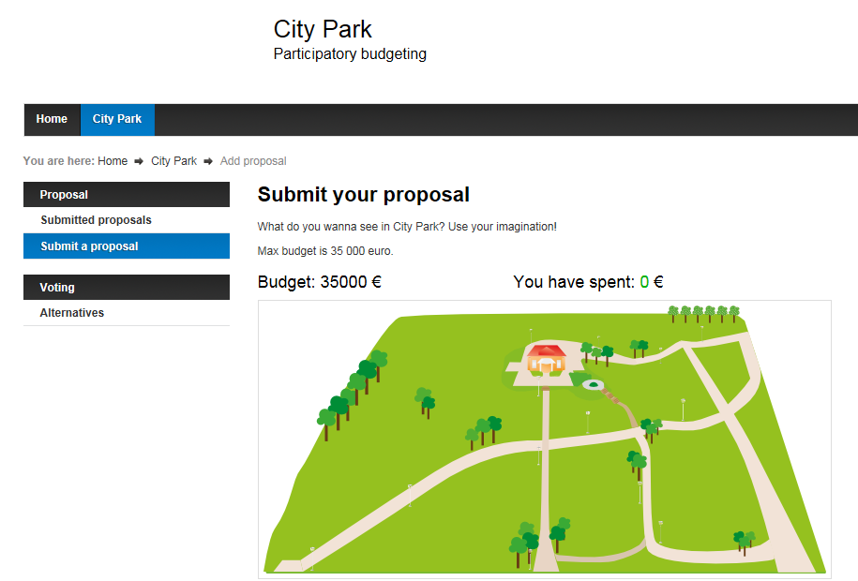
http://uk.medborgarbudget.se/

Slide 19
Choose from these ikons
http://uk.medborgarbudget.se/

Slide 20
Choose from these ikons
http://uk.medborgarbudget.se/

Slide 21
Choose from these ikons
http://uk.medborgarbudget.se/

Slide 22
Choose from these ikons
http://uk.medborgarbudget.se/

Slide 23
Place them where you want them but do not exceed the budget
http://uk.medborgarbudget.se/

Slide 24
http://uk.medborgarbudget.se/

Slide 25
http://uk.medborgarbudget.se/

Slide 26
Next step is the voting process
As a true Swedish chef we already have prepared three proposals to vote on!

Slide 27
Time to vote
http://uk.medborgarbudget.se/

Slide 28
Vote!
http://uk.medborgarbudget.se/

Slide 29
http://uk.medborgarbudget.se/

Slide 30
Experience: Most proposals from local residents

Slide 31
Total 196 proposal
113 with image or map
60 using the webb, 130 at the dialogue meetings

Slide 32
March 31th 2015 planning starts
Summer 2015 Park opening
October 13-26th Voting
September compilation of proposals
August 11-31th open for proposals

Slide 33
Thanks for takning part in this workshop!
Questions?
What can we do to improve PB in Sweden?

