Slide 1
Growing effective models of mainstream PB
Learning from Scotland, New York and Brazil

Slide 2
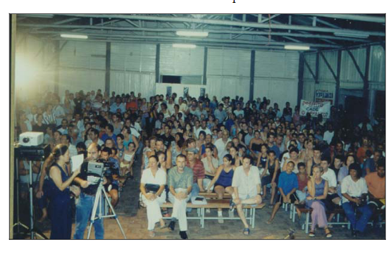
Brazil
The share of PB in total budget allocations had increased considerably. In Porto Alegre, for instance, 17 percent of the total budget was allocated through PB in 1992; this share grew to 21 percent in 1999.
An indicator of PB’s success is the enhanced level of participation. The number of participants in Porto Alegre grew from less than 1,000 per year in 1990 to more than 16,000 in 1998, to about 40,000 in 1999. Participation is not just restricted to the middle class or the conventional supporters of the Workers Party. People from low-income groups also take an active part in the process.

Slide 3
The Process
Participatory budgeting involves three parallel streams of meetings: neighborhood assemblies, “thematic” assemblies, and meetings of delegates for citywide coordinating sessions.
These meetings continue throughout the year. The first stream discusses fund allocations among 16 districts or neighborhoods of the city for the usual departmental responsibilities, such as water supply and sewage, street paving, parks, and schools.
The district-based meetings begin with 16 “great assemblies” in public places, including union centers, gyms, churches, clubs, and even a circus tent.
The city government’s “Presentation of Accounts” from the previous year marks the beginning of events every year. The government also presents its investment plan for the current year, as decided in the previous year’s meetings. Then a debate starts for the next year.
The debates continue for nine months, and each district gives two sets of rankings, one set for requirements within the district (such as pavement, school construction, or water lines), and the other set for efforts which affect the whole city (such as cleaning up the beaches).
A public debate decides the criteria for allocating investment budget among districts. These criteria can be population, an index of poverty, a measure of shortages (such as a lack of pavement or the lack of a school), the assigned priorities, and so on.

Slide 4
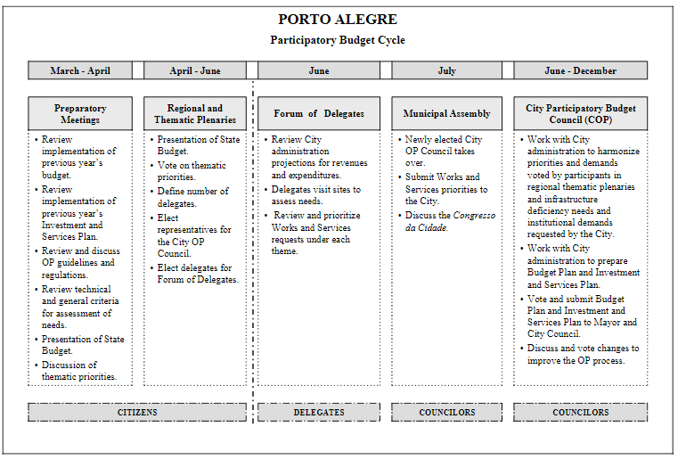

Slide 5
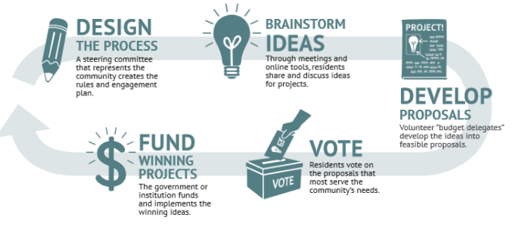
New York City
Participatory Budgeting in New York City (PBNYC) plays an important role in giving communities the ability to directly impact the capital budgeting process.
In 2019, 33 Council Members participated in PBNYC, asking residents how to spend at least $35 million in capital funding. Following a series of phases to produce a community ballot, projects that receive the most votes during a nine-day Vote Week are adopted in the City’s fiscal year budget.
About PBNYC - Participatory Budgeting

Slide 6
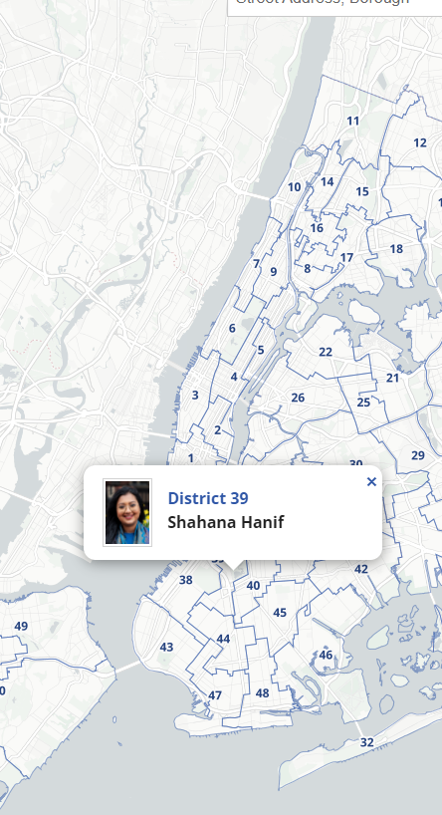
Process
1. Idea Collection and Volunteer Recruitment
August – October
Through community meetings, residents brainstorm ideas and recruit Budget Delegates for the current cycle.
2. Proposal Development
October – January
Budget Delegates transform ideas into full proposals, with support from city agencies and staff. Delegates narrow down proposals and select projects that meet the needs of the community.
3. GOTV and Vote Week
March – April
Once proposals have been determined, Budget Delegates and residents get out the vote and prepare for a nine day community vote.
4. Evaluation and Planning
May – June
Winning projects are included in New York City’s upcoming fiscal year budget. Staff and stakeholders evaluate the process and oversee the implementation of winning projects by agencies.

Slide 7
Scotland
1. Asking for ideas to develop Environmental Projects which can improve Health & Wellbeing of the community from groups and individuals. Budget delegates (community member) will work with officers and be on the project team for procurement and delivery of the project ideas. (100k)
2. Grounds maintenance – survey about the standards and priorities for this service. Options developed for each community to be confirmed by the community itself. Environmental improvements – asking for ideas through CONSUL. (150k)
3. Service redesign of outdoor spaces – listened to employees to redesign the services – now have place based hubs (established pre-covid) which engage with communities to set a minimum standard of service for a particular area. Community survey and engagement produced 3 options for each area and people were asked to vote on the one that they wanted. Anything above the minimum was celebrated as added value.
4. Environmental money through housing – Council and housing officers asked the community to come up with ideas about how to improve the area. Ideas were costed and then put out to vote on by housing tenants at events, by post and online
5. Looked at passenger transport where subsidies are allocated e.g. the late night bus, schools. Asked what is working well, dream about the futures, design the system and allocate budgets. A series of collaborative conversations (originally planned with service users and staff in Spring 2020) moved online in June and July via Zoom in a series of thematic and area-based workshops.

