Slide 1
Mainstream Participatory Budgeting in Scottish Local Authorities
Katey Taber
Policy Manager, Participatory Budgeting
COSLA
katey@cosla.gov.uk
www.cosla.gov.uk @cosla COSLA

Slide 2
What is Mainstream PB?
Participatory budgeting is a democratic process where local people decide how to spend public budgets and/or allocate resources.
Mainstream PB is not about separate budgets but bringing community voices and experiences into decisions on council spend which would be made anyway.
PB goes beyond consultation and engagement to promote the active participation of communities in the allocation of local budgets and resources
Results in services which are more responsive to local need but also highlights to the community how the council is responding to local priorities.
Notes:
Important to recognise that mainstream PB is not about separate budgets but bringing community voices and experiences into decisions on council spend which would be made anyway.
It results in services which are more responsive to local need but also highlights to the community how the council is responding to local priorities.

Slide 3
Why Mainstream PB?
Involves communities participating not only on grants and discretionary spend but also on core budget decisions relating to service delivery and priorities.
Devolves decisions to a local level, creating opportunities for service innovation whereby communities develop local solutions to local issues.
Deliberation as part of PB encourages a focus on consensus building through deliberation of key issues and coproduction of solutions.
Ensures public services remain democratically accountable to local people and meet the needs of those who use them.
Empowers underrepresented/equalities groups to actively participate in service design to ensure councils best meet equalities duties.
Enhances the role of elected members as advocates for the needs of their communities.

Slide 4
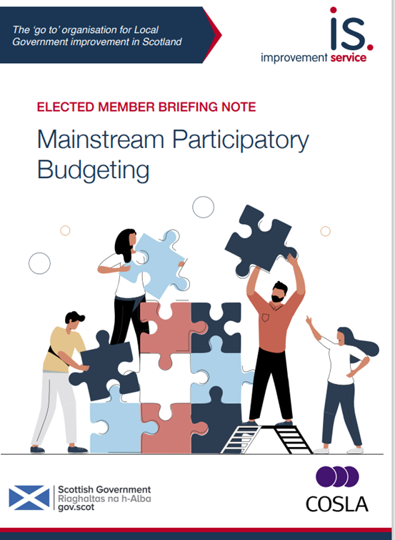
Design Considerations
Purpose
Design
Facilitation
Participation
Ideas Generation
Scope
Decision making
Outcomes
Notes:
Mainstream PB looks to engage communities/members/partners in many stages of the process.

Slide 5
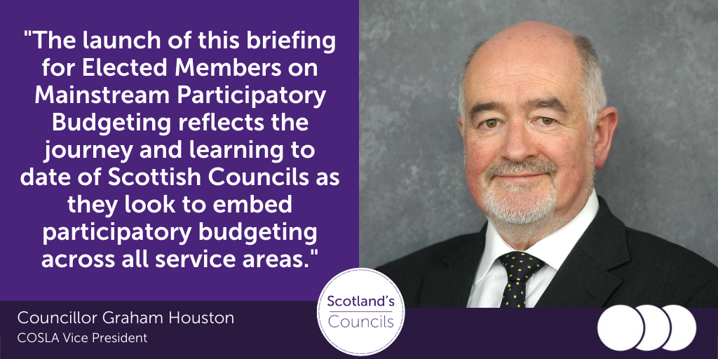
PB and Elected Members
Notes:
Also be looking to host national training events in June and July 2022 which will include international speakers to discuss how PB and deliberative democracy can enhance the role of elected members.

Slide 6
Public participation in Scotland (Scottish Social Attitudes Survey 2015, 2017 + Ipsos Mori 2014)
Why Participation?
A 2014 study of Lisbon’s PB an in an increase of over 25,000 participants in 4 years.
2008: 2,809 voters
1,732 participants
580 projects
2012 : 24,911 voters
26,815 participants
659 projects
35% of Scottish citizens feel part of how decisions affecting their community are made
96% said that people should be involved in making decisions about how local services are planned and run
80% said that people should be involved in deciding how money is spent on local services
77% would get more involved in their community if it was easier to participate in decisions that affect it
Notes:
PB can help
Add in international evidence for impact of PB
Lisbon study Allegretti and Antures (2014)
2008: 2,809 voters
1,732 participants
580 projects
2012 : 24,911 voters
26,815 participants
659 projects
https://journals.openedition.org/factsreports/3363#tocto1n1

Slide 7
Bringing communities into local decision making
PB is an opportunity for Elected Members to learn about priorities of local communities
Enhances the role of elected members in representing community interests e.g. committee decision making
Opportunity for members to share complex decision making with those who have lived experience – deliberation and votes
Encourages an enhanced focus on equalities through deliberation and consensus building across communities
Notes:
Participatory budgeting activity enhances and supports the role of members.

Slide 8
Wider impacts of PB
“Increased involvement of local people in decision making re council budgets and local service delivery.
PB is a means to devolve budget decisions to a local level, developing local solutions to local issues.
A fantastic opportunity for local people/groups to network, learn about each other and share resources.
Better understanding about what council services do.”
Notes:
Enhance the relationship and role of members with the community

