Slide 1
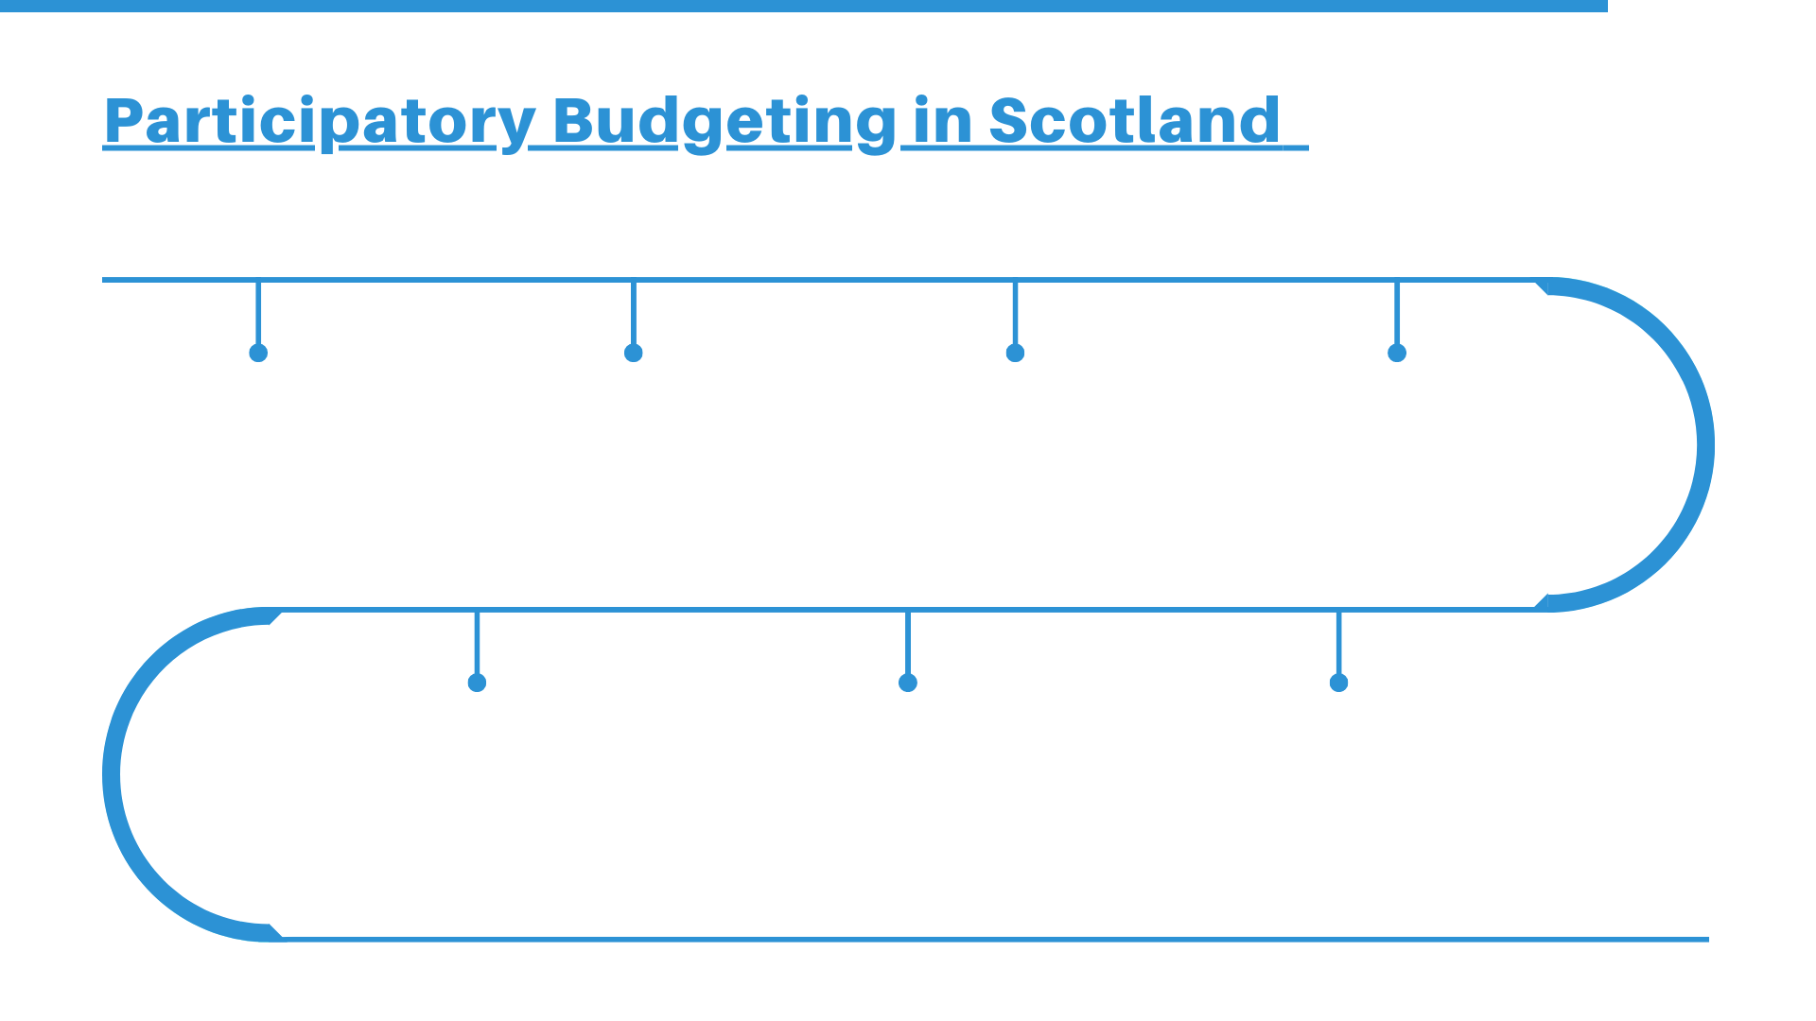
Pre-2013: Early PB takes place across Scotland, including Leith Decides and Coalfields Regeneration Trust.
2013: The Commission for Strengthening Local Democracy is launched with reference to PB.
2014: Scottish Government commits to support and promote PB - PB Working Group established.
2014: PB experts provide training across Scotland to introduce PB to Local Authorities.
2015: Local Authorities such as Glasgow, Highlands Ayrshire Councils and Midlothian and more begin their PB pilots.
2015: PB Scotland website launched by Scottish Community Development Centre and funded by Scottish Government.
2016: PB Scotland holds the two-day International PB conference for more than 200 people.

Slide 2
2016: Scottish Government announces £2m Community Choices Fund - 33 organisations disburse £1.7m.
2017: PB Scotland Conference sees people come together to discuss PB’s progress across Scotland.
2017: All 32 Local Authorities across Scotland agree to make 1% of council budgets subject to PB as part of COSLA / Scottish Government Framework Agreement.
2017: Scottish Government commit further £2m to Community Choices Fund. 33 organisations disburse £1.5m through PB.
2017: 39,484 people voted for 2,058 activities and projects at 122 PB events through Community Choices
2017: Glasgow Disability Alliance to explore barriers to PB for disabled people in Scotland.
2018: PB Scotland Festival takes place with two days of events, discussions, and ideas around PB all across Scotland.

Slide 3
2018: ‘Moving Toward the Mainstream’ film launched by PB Scotland, Glasgow City Council and funded through the Community Choices Fund.
2017: Local Authorities match fund £2,365,686 Project Funding for PB in Scotland.
2018: 57,721 voters 526 community events run by community groups and local councils through Community Choices.
2018: 17 Community organisations disburse £790,217 to local groups and causes.
2018: GDA’s Budgeting for Equality shows what needs to happen for PB to be truly inclusive for disabled people.
2019: The Scottish Government publishes the Glasgow Caledonian report which evaluates the impact PB has had in Scotland from 2016-18.
2019: 1,000 people become members of the PB Scotland Network.

Slide 4
2018: ‘PB Charter for Scotland’ launched: co-produced by community organisations and agencies.
2019: Scotland included in the Global Atlas for Participatory Budgeting for the first time.
2019: The PB Scotland Conference 2019: Going Global sees more than 200 people from countries across the world come together in Edinburgh.
2020: Scottish Government publishes Pupil Equity Fund guidance 2021-21, including clear reference to using PB in schools.
2020: Global Pandemic sees Scotland’s PB activity moved entirely online.
2020: New national PB Strategic group launches to support the development of participatory budgeting across Scotland.
2021: New research explores digital tools for PB in Scotland.

